Slide 1
Bug Detection and Fixing Project
Debayan Ghosh
Brainware University
BWU/BTA/22/157

Slide 2
Data Extraction & Preprocessing:
Collected the the mass dataset of Python code snippets by Scraping Github and w3schools etc using my script.
Labeled the scraped data as “buggy” and “bug-free” based on the Pull Request status for the repository.
Model Architecture:
I fine tune my model using microsoft/codebert-base for my bug-detection model and I fine tune my bug-fixing model using the popular deepseek-ai model.
This models can help to “detect” the code and “fix” them according to the most weighted answer.
Evaluation and Testing:
After fine tuning the model I will test and evaluate them to check the status of accuracy score, F1, Precesion , underfitting/overfitting status etc.

Slide 3
Data Preprocessing:
After scraping and labeling the dataset I found some of them consists “null” or some invalid character (*&^%) so I code a script to process the dataset so that I can use this for model training.
Model Training:
After the dataset being prepared and after the fine tune model preparation I trained the “bug-detection” model so that it can classify any python snippet as “buggy” or “bug-free” based on
The semantic rule of the code.
The fix will be the most accurate predicted fix/patch according to the model.
We can get the comment for the code [if we want]

Slide 4
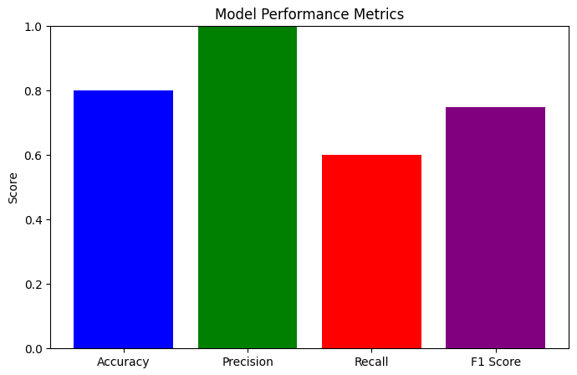
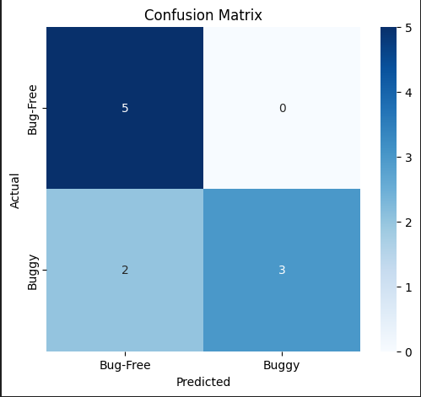
Evaluation Matrics for the model
After creating the model I have tried to test the model according to the input dataset and I found
Based on them I got the accuracy of 80% with neither underfitting nor overfitting.

Slide 5
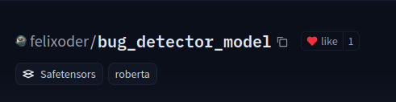
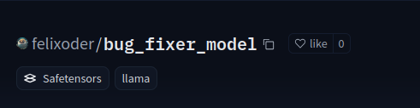
Deploying my model:
After successfully evaluating the both model I deployed them to huggingface for general use
Using my model:
After Productionize the model I have implemented them to my vs code extension where people can detect/fix their code “in-place” in their code editor even they are offline.
The extenstion is build on top of typescript and bash script.
https://marketplace.visualstudio.com/manage/publishers/debayanghosh/extensions/felix-detect-fix

Slide 6
Tools I have used:
Google colab
Jupyter notebook
huggingface
wandb
GCP engine
Intel devcloud
typescript
vsix model
Research Papers

Slide 7
References
https://www.researchgate.net/publication/376609474_Software_bugs_detection_analysis_and_fixing
https://papers.ssrn.com/sol3/papers.cfm?abstract_id=4662187
https://ieeexplore.ieee.org/document/9270312
https://github.com/felixoder/bug_detection_ml_project/

Slide 8
Thank You

